Slide 1
TNGS Learning Solutions AWS Solutions Architect Online Course INTRODUCTION TO Amazon Web Services

Slide 2
AWS (Amazon Web Services)
Amazon Web Services (AWS) is a comprehensive and widely-used cloud computing platform offered by Amazon.
It provides a vast array of cloud services, including computing power, storage, databases, machine learning, analytics, security, and more.
AWS allows individuals, businesses, and organizations to access and utilize these services on a pay-as-you-go basis, enabling them to build and scale applications and infrastructure without the need for substantial upfront investment in physical hardware and data centers.

Slide 3
AWS (Amazon Web Services)
Scalability: AWS offers the flexibility to scale computing resources up or down based on demand, ensuring that you have the right resources available when you need them.
Global Reach: AWS operates data centers in multiple regions and availability zones worldwide, providing low-latency access to services for users and customers around the globe.
Reliability: AWS data centers are designed for high availability and redundancy, minimizing the risk of service interruptions and data loss.

Slide 4
AWS (Amazon Web Services)
Security: AWS implements robust security measures and provides a wide range of tools and services to help users secure their data and applications in the cloud.
Cost-Efficiency: With the AWS pay-as-you-go model, users only pay for the resources they use, reducing upfront capital expenses and allowing for cost-effective scaling.
Broad Service Portfolio: AWS offers over 200 fully-featured services across various domains, including computing, storage, networking, machine learning, analytics, IoT, and more.

Slide 5
AWS (Amazon Web Services)
Developer-Friendly: AWS provides developer tools, APIs, and SDKs to streamline application development and deployment processes.
Managed Services: AWS offers managed services that handle administrative tasks such as patching, monitoring, and scaling, allowing users to focus on building applications rather than managing infrastructure.
Hybrid and Multi-Cloud Support: AWS offers solutions for hybrid and multi-cloud deployments, allowing organizations to integrate their on-premises infrastructure with AWS services or use multiple cloud providers.

Slide 6
Region and Availability Zone Relation
Amazon Web Services (AWS) divides its global infrastructure into multiple Availability Zones (AZs) as part of its strategy to provide high availability and fault tolerance for cloud services.
Each AWS region consists of multiple Availability Zones, and these zones are essentially isolated data centers or facilities within that region.

Slide 7
Availability Zone
Purpose of Availability Zones
Availability Zones are designed to provide redundancy and resiliency for AWS services and applications. They offer isolation from failures that may affect other zones within the same region.
The primary goal is to ensure that if one Availability Zone experiences an outage due to hardware failure, network issues, or other unforeseen events, the services and applications can continue to operate in other zones without significant disruption.

Slide 8
Availability Zone
Number of Availability Zones:
The number of Availability Zones within an AWS region can vary and may increase over time.
There are at least 2 availability zones within each AWS region.
Some regions have three or more Availability Zones, providing even higher levels of redundancy.

Slide 9
Availability Zone
Availability Zone Independence:
Availability Zones are physically separated from one another within a region and are built with their own power, cooling, and networking infrastructure.
Failures that affect one Availability Zone are unlikely to impact others, ensuring a high level of fault tolerance.

Slide 10
Availability Zone
Cross-AZ Traffic:
AWS allows data traffic to flow freely between Availability Zones within the same region without incurring data transfer fees. This enables the construction of highly available and fault-tolerant architectures.
Use Cases:
Organizations can leverage Availability Zones to distribute workloads, databases, and storage across multiple zones to improve resilience.

Slide 11
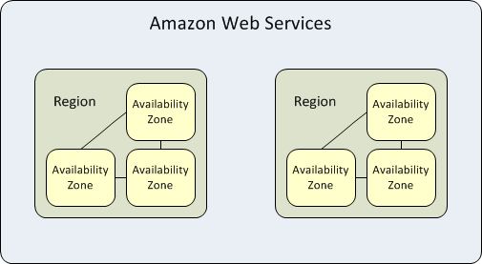
Region and Availability Zone Relation

Slide 12
Conclusion
When architecting applications on AWS, it is highly recommended to distribute resources across multiple Availability Zones to maximize availability and fault tolerance. This approach will help client achieve high levels of resilience and ensures that their applications remain operational even in the face of unexpected events or failures within a single Availability Zone.

